Slide 1
Introduction to AutoML

Slide 2
Agenda
The Machine Learning Pipeline
What is AutoML? An Overview
Hyperparameter Optimization
Neural Architecture Search
Meta-Learning

Slide 3
Some Rules

Slide 4
Some Rules
Please follow these rules during the online-workshop:
stay muted (except if you are allowed to speak up of course!)
write questions in the chat
during discussions use the “raise hand”-feature

Slide 5
Setup

Slide 6
Get the Code Running!
Clone code: git clone https://github.com/J0nasSeng/AutoML-Workshop.git
if you have Jupyter Notebook & Python installed → feel free to choose your favorite editor
if you have Jupyter Notebook & Python not installed → use e.g. Google Colab
Notes:
git clone https://github.com/J0nasSeng/AutoML-Workshop.git

Slide 7
Setting up Google Colab
open Colab: https://colab.research.google.com/
open File → Open Notebook
Select GitHub
Enter https://github.com/J0nasSeng/AutoML-Workshop.git
Select Notebook we are currently using
NOTE: You have to upload the data-directory separately!

Slide 8
The Machine Learning Pipeline

Slide 9
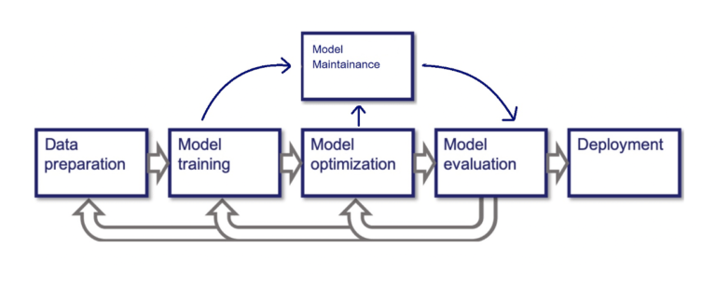
The Machine Learning Pipeline
Notes:
this figure shows the typical Machine Learning Pipeline as it is used in many industrial and academic settings
Data preparation:
bring data into appropriate formats, clean data, transform data, sanity checks, check for imbalances/biases …
Model Training:
design and train a model on the prepared data
Model Optimization:
many models have many hyperparameters
tune them until you see the best performance of your model
also: select best model-type, i.e. we train multiple models, e.g. Random Forests, Neural Networks, …
Evaluate Model:
check if the model generalizes well on unseen data
Deployment:
make model accessible for users
process is not really a pipeline, more a cycle!

Slide 10
What is AutoML? An Overview

Slide 11
What is AutoML? An Overview
Data Cleaning & Data Generation
Hyperparameter Optimization
Data Augmentation
The set of methods aiming at automating (parts) of the Machine Learning Pipeline
Collecting Data (crawling)
Meta-Learning
Neural Architecture Search
…
Notes:
AutoML is the set of methods trying to automate the ML-pipeline
no constraints how they do it: even a Random Search is AutoML!
has connections to many other branches of science:
Optimization
Machine Learning & Statistics
Neuroscience/Cognitive Sciences (Meta-Learning)
Natural Language Processing
…

Slide 12
Hyperparameter Optimization

Slide 13
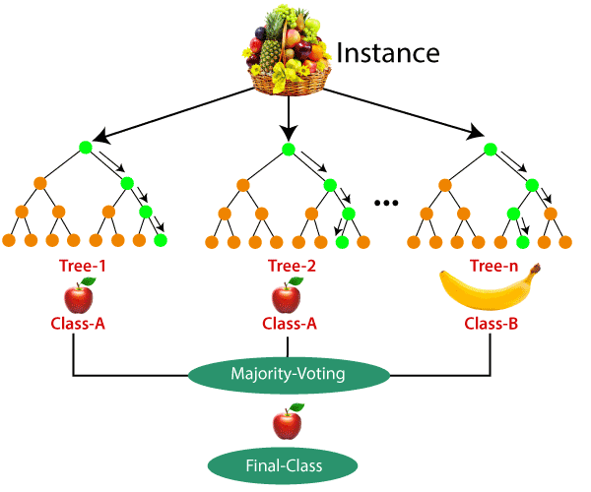
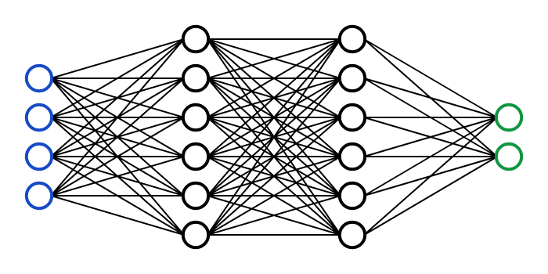
Problem Definition
Given an unknown function f: Ө x 𝓧 🠒 ℝ with possible constraints ℂ, find ө ∈ Ө such that f(ө, x) is minimal and fulfills all constraints c ∈ ℂ for some x ~ p(X) where p is a distribution over 𝓧
Notes:
some things to note:
f is not known, i.e. we don’t have gradients and no closed form
f depends on both, the hyperparameters and the data. Selecting a set of hyperparameters can possibly induce another set of model-parameters which have to be learned, thus forming a two-level optimization problem
we will ignore constraints for now, but in real world we typically have some (e.g. runtime, number of GPUs, …)

Slide 14
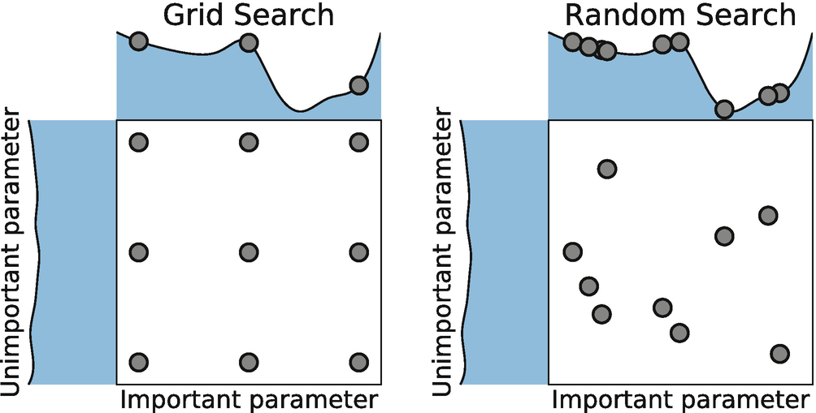
Grid/Random Search
Random Search picks hyperparameter-configurations randomly and evaluates them
RS works better than GS in general
however: only efficient for low number of hyperparameters and if model training is not too expensive

Slide 15
Grid/Random Search
Advantages | Disadvantages
easy to implement | resource-intensive, especially for big problems
easy to parallelize | does not include prior knowledge about hyperparameters (i.e. it doesn’t learn)
will find good hyperparameters in the long run | wastes resources by unnecessary exploration

Slide 16
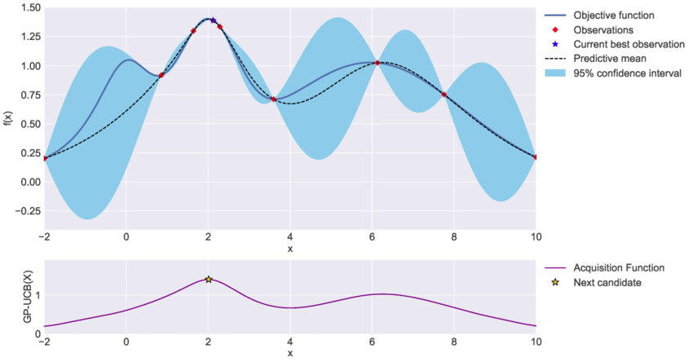
Bayesian Optimization
the problem with RS: we blindly search for hyperparameter-configurations without taking prior evaluations into consideration
BO tries to solve this:
we start sampling a configuration from a prior distribution and evaluate the sampled configuration
after this we update our prior distribution using Bayes Rule
the updated distribution is used to select the most promising configuration using an acquisition function (e.g. we choose the one with the lowest/highest expected value)

Slide 17
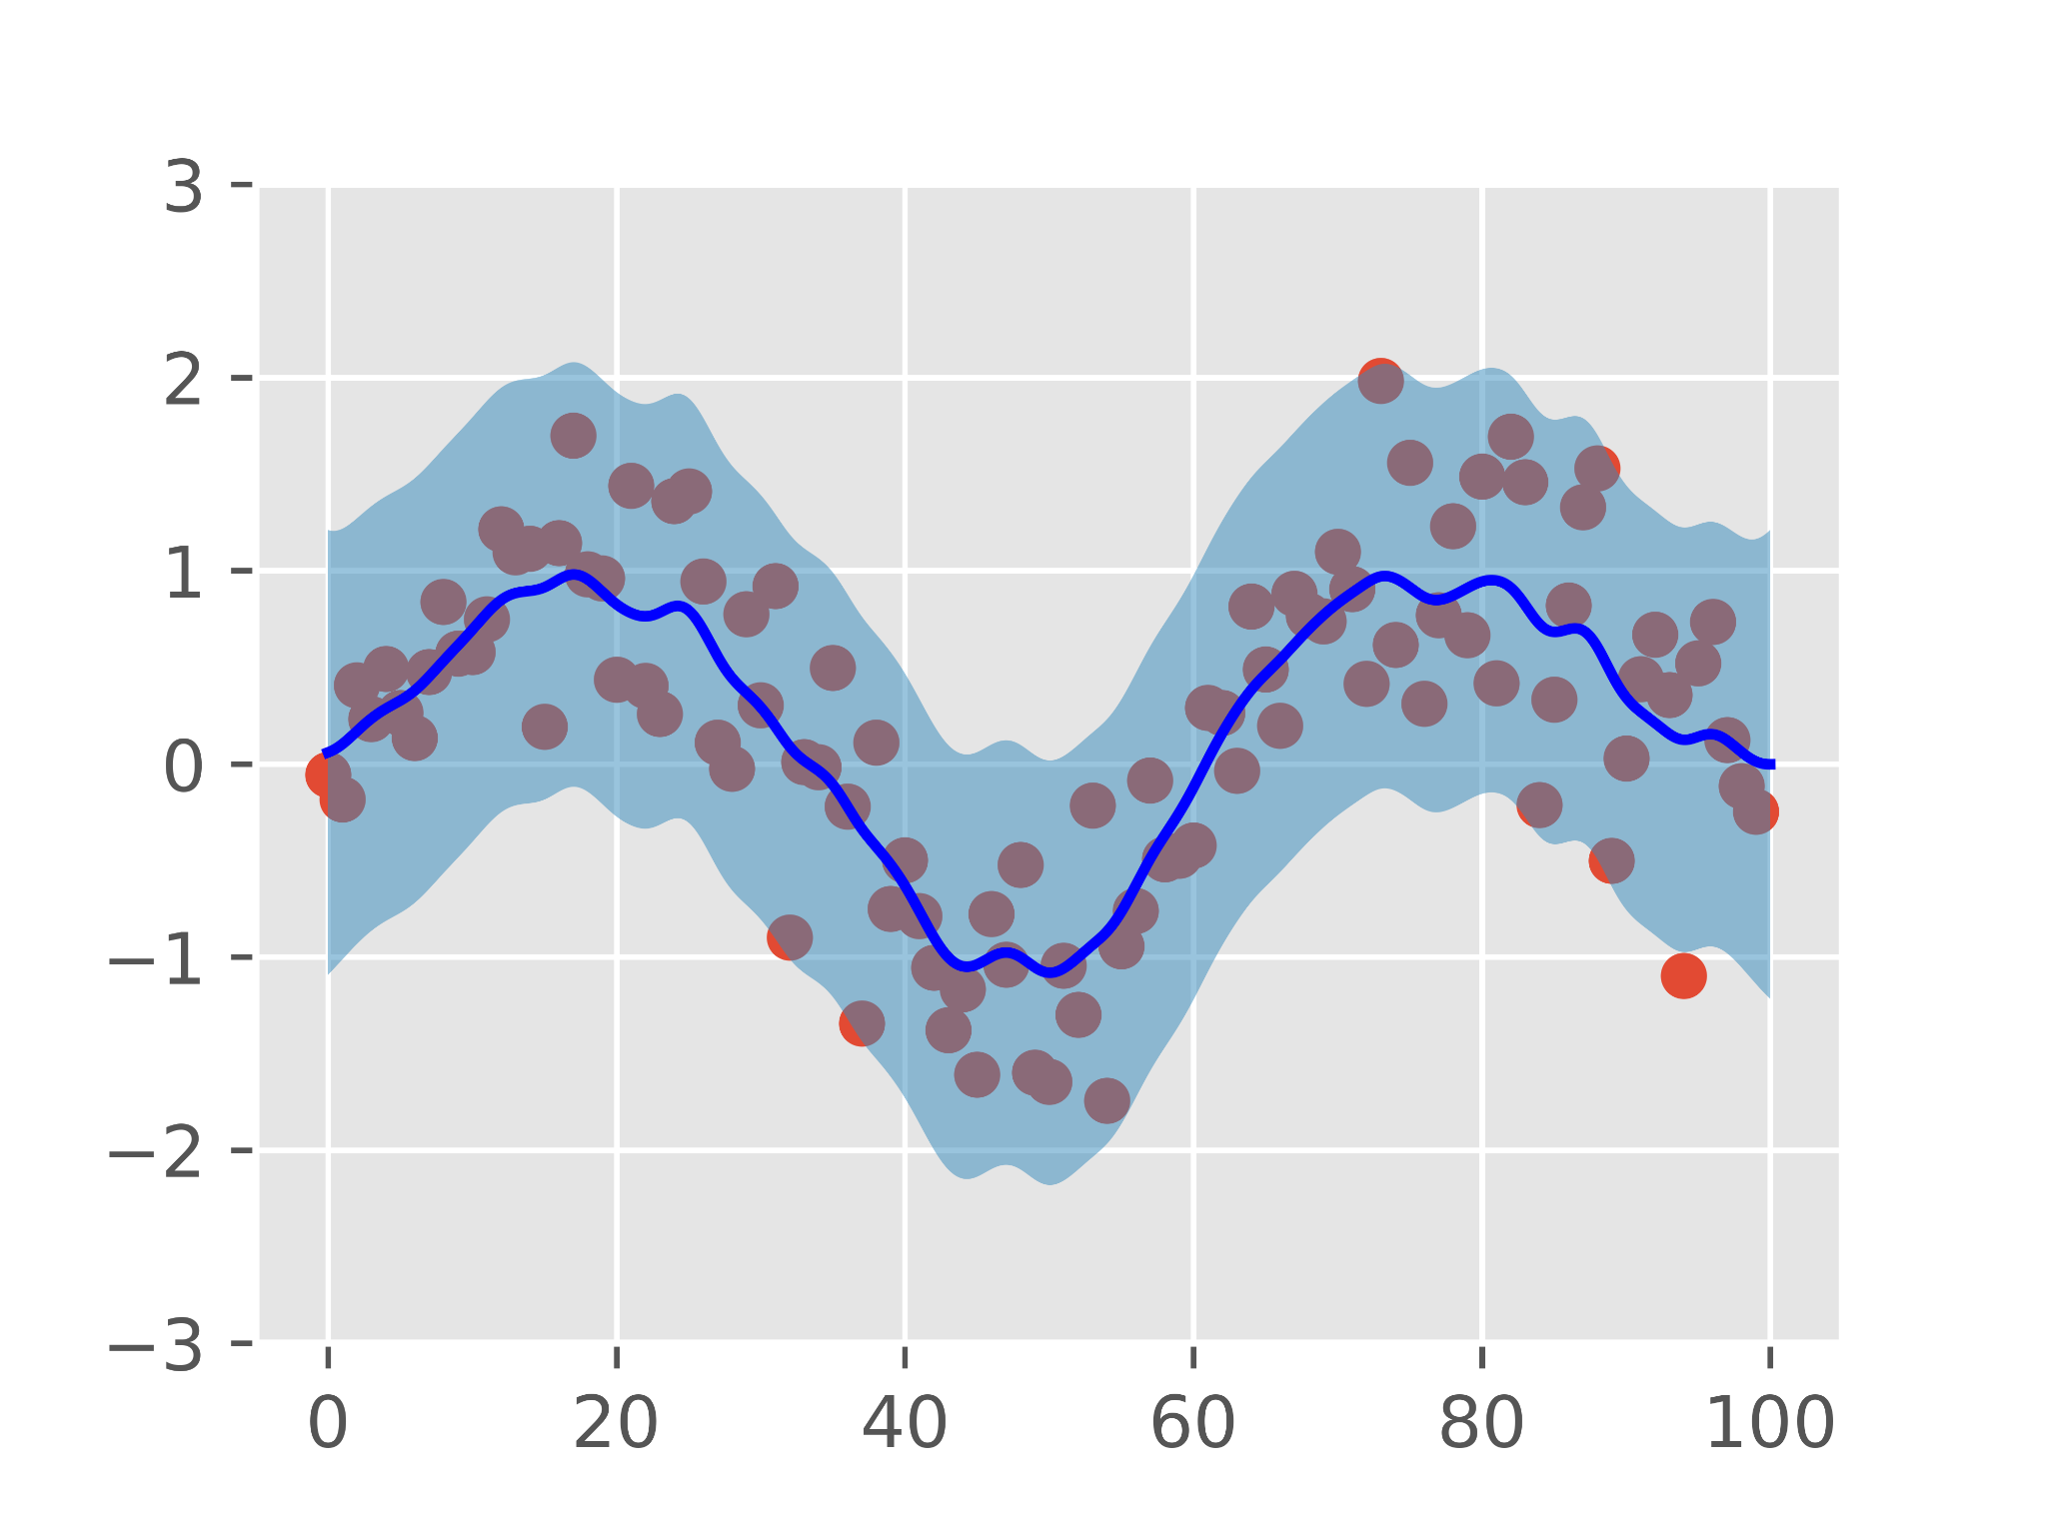
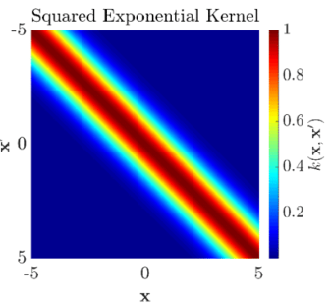
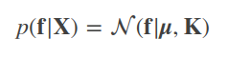
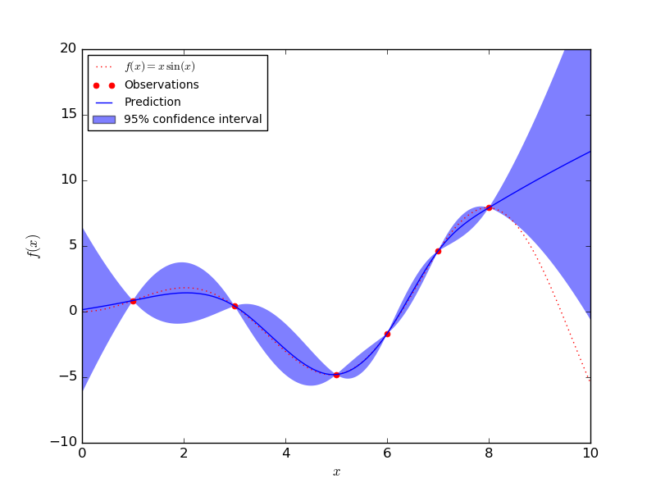
Bayesian Optimization with Gaussian Processes
Intuition: Constrain possible functions to the subset of functions going through obtained Y
Notes:
f is a tuple of random variables, X an index set, mu is a mean-vector and K is the covariance-matrix determined by some kernel function k(x, x’)
p is Guassian
imagine a 2-d coordinate system. The x-axis is the index set, i.e. we have infinite many random variables, each determining a probability score to each y-value
this can be interpreted as a Gaussian over functions
we can compute the probability of obtaining a certain function-value (y) by plugging in a vector of x-values
assuming a mean of 0, the kernel function then fully determines the Gaussian, i.e. depending on the x-values in your vector, the kernel implies dependencies among the random variables
in the figure above you can see that the function is smooth, i.e. the kernel introduces a high correlation between near x-values and makes points far away from each other nearly independent
doing regression with GPs is simply conditioning on training data Y
by conditioning we get a closed form formula (nevertheless pretty complex, we won’t do the derivation here)
with this we intuitively “constrain” the possible functions to those which go through the training points Y

Slide 18
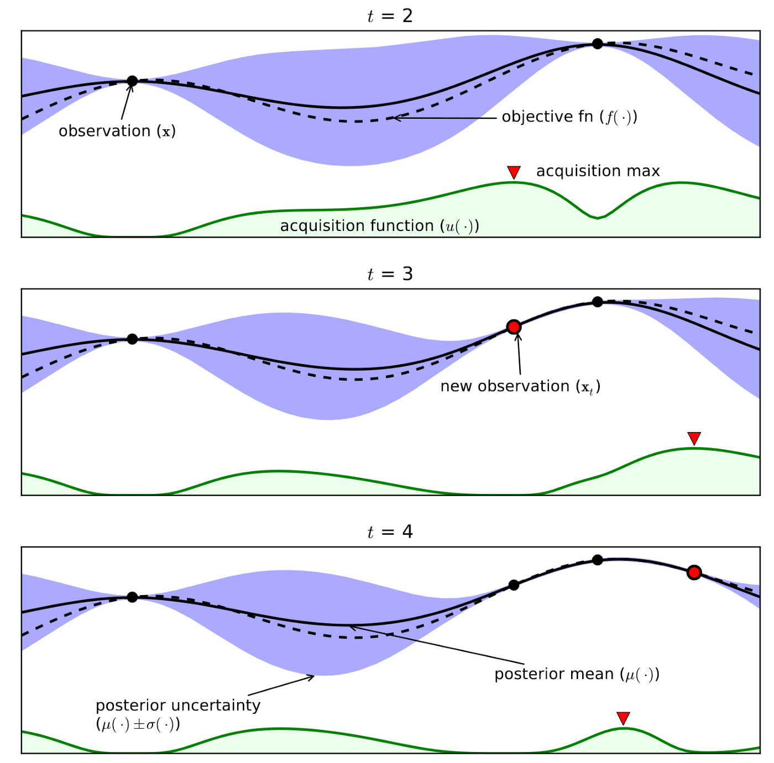
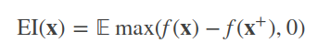
Bayesian Optimization with Gaussian Processes
Intuition: Constrain possible functions to the subset of functions going through obtained Y
We then still have to find the next value we suspect to optimize our objective. We do that using acquisition functions, for example Expected Improvement (EI):
Notes:
after we’ve seen how to use GP as a surrogate model, we still have to optimize our modelled function
how can we do that?
here another nice property of GPs can be exploited: there are numerous acquisition functions that have closed form solutions under the GP model
for example: Expected Improvement
intuition: for each possible x we compute the expected improvement w.r.t. to f(x+) where x+ is value where f(x) is max at the moment
under GP this yields a function we can simply optimize

Slide 19
Bayesian Optimization with Gaussian Processes
Advantages | Disadvantages
easy to implement | scales cubic in the number of training points
regression = conditioning -> we can exploit properties of Gaussian RVs | not well in high-dimensional hyperparameter-spaces
we can give theoretical guarantees
sample efficient
we can give uncertainty measures

Slide 20
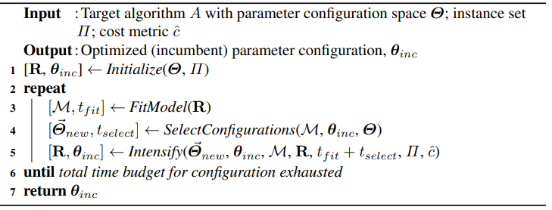
Sequential Model-Based Algorithm Configuration (SMAC)
Intensify
Select Configurations
Initialize
Fit Surrogate

Slide 21
SMAC - The Phases
Initialize
sample a configuration from the configuration space and a problem instance & run target algorithm once
report performance of target algorithm
Fit Model
given configuration-performance-pairs (𝜽, o), fit Random Forest to model relationship
as an extension RF can also be fitted incorporating features x describing problem instance
x would be meta-knowledge in context of HO in ML that is shared across tasks (we’ll see this later)
Select Configuration
Expected Improvement (EI) is computed for a subset of configurations 𝜽
next configurations computed by:
compute EI for each 𝜽 seen so far
pick 10 best
compute neighbours of 10 best (by manipulating them)
run local search to find a set of good configurations
Intensify
basically an uncertainty-reduction mechanism
each configuration selected by previous step is tested as long as it is not worse than the best configuration seen so far
as it gets worse once → reject
if it does not get worse → accept as new “best” configuration

Slide 22
SMAC
Advantages | Disadvantages
very effective | less sample efficient than BO with GPs
uses cheap and simple surrogates (RFs) | intensify mechanism can be very resource-intensive
can give uncertainty measures (approximately) | no theoretical guarantees
reduces uncertainty by testing configurations multiple times
works well with high dimensional, mixed configuration spaces

Slide 23
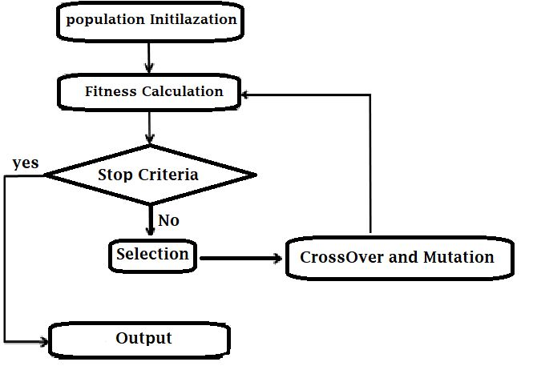
Genetic Algorithms
two basic operations: mutation and crossover
mutation: randomly change a part of the “gene”
crossover: choose best performing “genes” and mix them randomly

Slide 24
Genetic Algorithms
Advantages | Disadvantages
easy to implement | not very sample-efficient
constraint exploration to promising regions of search space | curse of dimensionality (in the sense of high-dimensional hyperparameter-spaces)

Slide 25

Reinforcement Learning
in our case: R_{t} is performance measure, A_{t} is selection of hyperparameters and state S_{t} can be anything
sometimes S_{t} is omitted, resulting in a simpler bandit-problem
Notes:
we will come across this in detail in NAS

Slide 26
Reinforcement Learning
Advantages | Disadvantages
allows for arbitrarily complex agents (even use of NNs) | not very sample-efficient
can handle large search spaces | come with own hyperparameters
learned policies can be reused | resource-hungry

Slide 27

Hands-On Time!

Slide 28
Neural Architecture Search

Slide 29
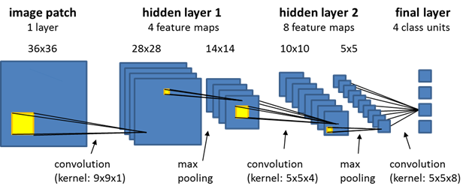
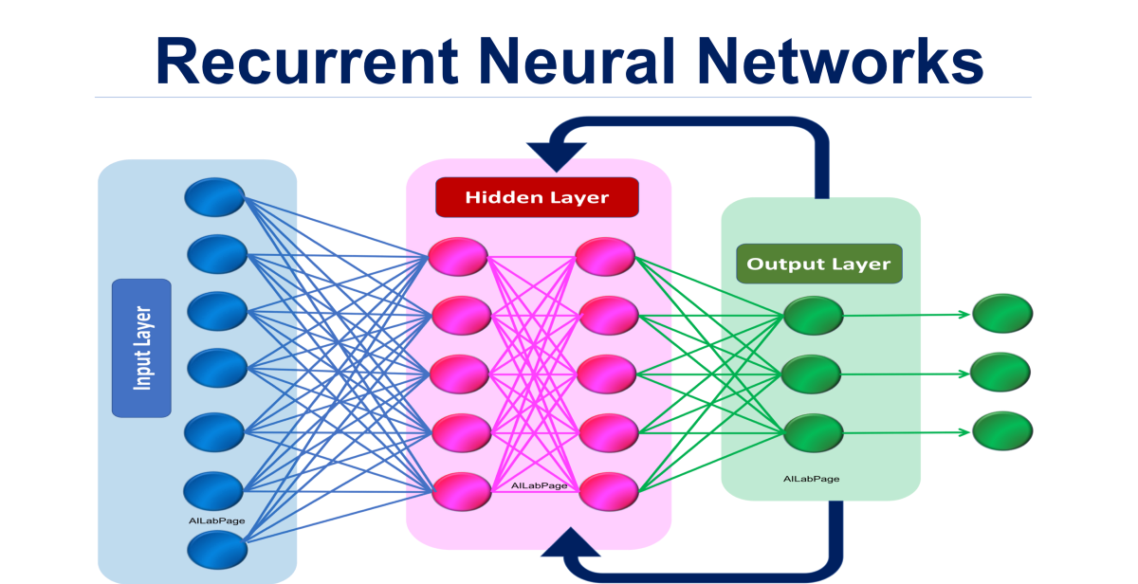
What is Neural Architecture Search (NAS)?
…
Notes:
there are many different types of NNs (CNNs, RNNs, MLPs, Transformers, …)
even if we know a good type: how many layers? how many neurons per layer? which activation functions? …

Slide 30
Naive Approaches
simply reuse what we know from HO:
Genetic Algorithms
Bayesian Optimization
Random Search
…
and yes, neural architectures are hyperparameters!
but: the known approaches don’t scale well, they ignore crucial requirements of NAS (in the ML-lingo: they have a bad inductive bias for NAS)

Slide 31
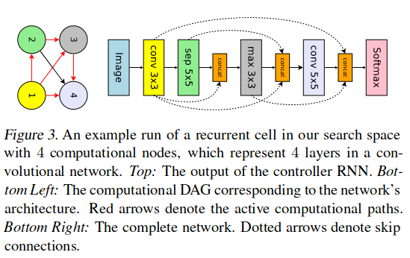
“Efficient” NAS (ENAS)
key insights:
neural networks are Directed Acyclic Graphs (DAGs)
after adjusting the architecture, we don’t have to retrain everything from scratch (parameters can be shared across architectures)

Slide 32
ENAS - Architecture
Controller-RNN
Phase 1: fix 𝜽 and train 𝝎
Phase 2: fix 𝝎 and train 𝜽
𝜽
sample
Neural Network
l(𝒚, 𝒚’)
𝑿
l(𝒚, 𝒚’)
𝝎
backprop
Notes:
ENAS has a controller RNN which samples architectures
RNN is trained using REINFORCE, a RL-based learning algorithm
sampled architectures are architectures from a specified search space
each operation in this space has only one parameterization, i.e. parameters are shared across architectures
training happens in 2 phases:
first phase: fix RNN and sample architectures according to policy. Train these architectures and average loss to obtain an estimate of loss w.r.t. the search space
second phase: fix network parameters and train RNN by pushing RNN-parameters towards a direction s.t. good architectures are sampled. Reward can be anything (e.g. validation loss, accuracy, …)

Slide 33
ENAS
Advantages | Disadvantages
efficient in contrast to other methods | still long runtimes
RNN can be reused for similar problems | no guarantees on optimality
easy to design search space

Slide 34
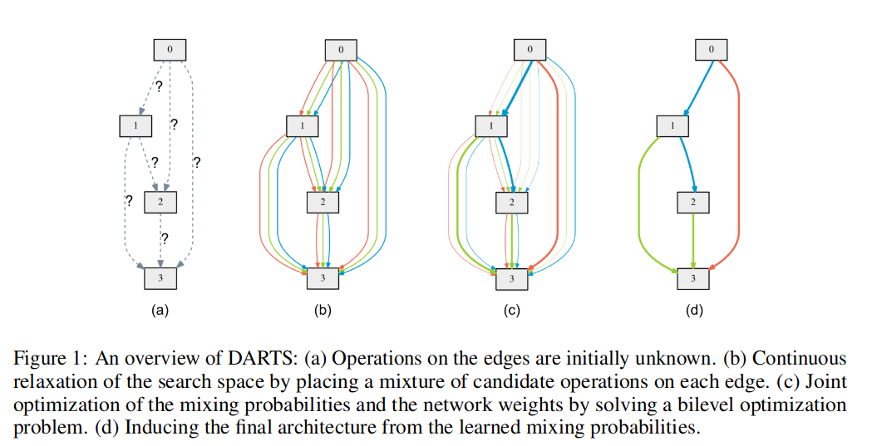
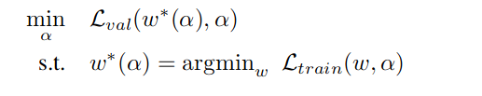
Differentiable Architecture Search (DARTS)
based on key idea of ENAS: Define search space as a single DAG
instead of a RNN producing architectures, we use standard SGD to optimize DAG itself

Slide 35
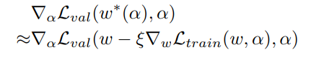
DARTS: Optimizing Architecture and Parameters
Architecture Step
one step of SGD on architecture
Parameter Step
one step of SGD on parameters

Slide 36
DARTS
Advantages | Disadvantages
very efficient | has shown insatiable behavior
SGD can be used to tune architecture | no guarantees on optimality
easy to design search space

Slide 37
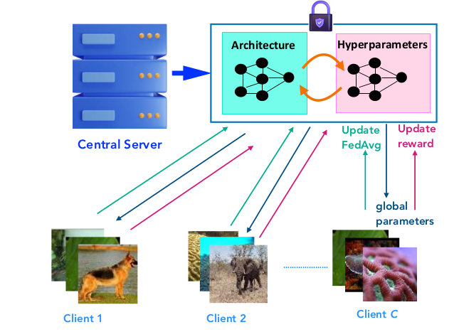
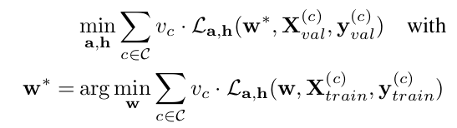
FEATHERS
ML is no longer being done on one machine: NAS has to be done distributed/federated
common NAS-algorithms don’t tune other hyperparameters: this should be changed!

Slide 38
FEATHERS’ Optimization Strategy
Stage 1:
HO
using a bandit-approach
NAS
using DARTS on clients & FedAvg
set architecture a found during first stage
HO
using a bandit-approach
SGD
using architecture a & FedAvg
Stage 2:

Slide 39
FEATHERS
Advantages | Disadvantages
efficient since based on DARTS | sometimes inherits instable behavior of DARTS
SGD can be used to tune architecture | more resource-intensive due to added HO
easy to design search space
optimizes arbitrary hyperparameters on top of architecture
operates in distributed/federated scenarios

Slide 40
Hands-On Time!

Slide 41
Meta-Learning

Slide 42




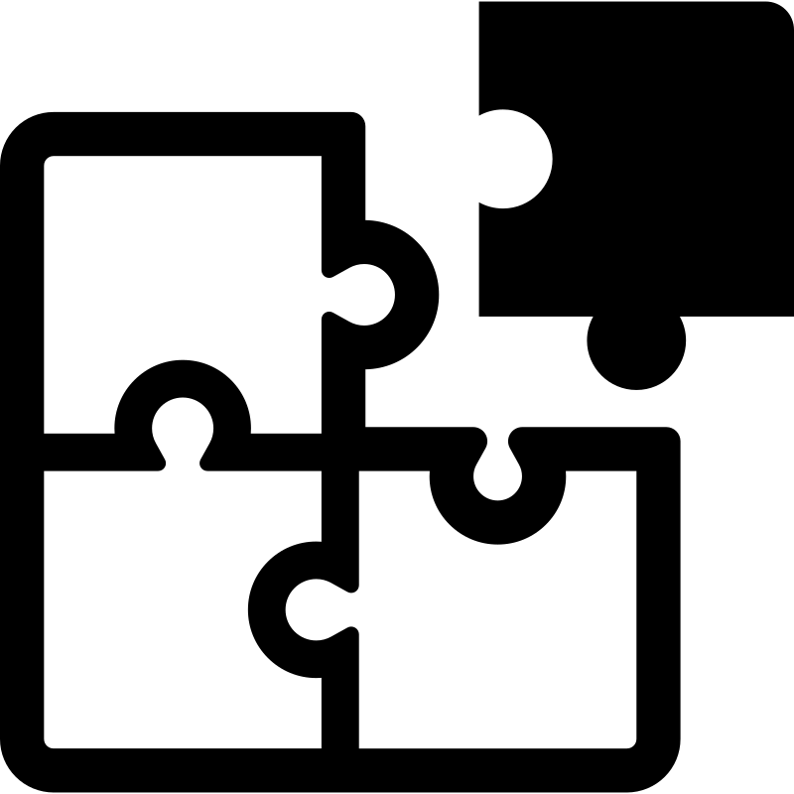
What is Meta-Learning?
meta-learning = learning to learn
i.e. identify domain-independent knowledge that helps us learning future tasks better/faster
Tent
Ball
Shoe
Notes:
meta-learning = learning to learn
example: assume an infant is learning to puzzle
in the beginning, the infant focuses on one puzzle-piece and randomly chooses other pieces to identify a fitting one for the one in focus
after a while, the infant recognizes that looking at the shape of the pieces helps to exclude a big set of pieces without even trying. The infant learned to look at the shape, it learned a certain task.
but there’s more about looking at shapes: Next time the infant faces a harder puzzle with pieces looking completely different, the same strategy is applied and turns out to be beneficial
even in tasks that have nothing in common with puzzling at the first glance this knowledge helps learning faster: Years later, the former infant is confronted with assigning names to shapes of shadows, a similar strategy is applied: Looking at the shape constraints the possible set of names fitting to a certain shape. The underlying knowledge that helped to learn the new game was: looking at the shape of objects and thereby constraining the set of possible solutions
automatically extracting and representing such knowledge to be used at arbitrary future points is exactly what meta-learning aims for
why is it relevant for us?
of course makes learning faster and more stable
helps to find new learning algorithms that were unknown
at some point: might help to group/cluster certain aspects of domain-independent knowledge or even algorithms

Slide 43
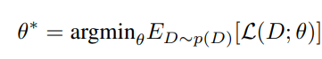
What is Meta-Learning?
instead of optimizing model parameters s.t. they minimize some loss over a single dataset, we aim to solve the following problem:
here, p(D) is a distribution over tasks/datasets

Slide 44
Task-Independent Approaches
Task | Number of Trees | Tree Depth | Split-Criterion | Accuracy
1 | 3 | 2 | entropy | 0.7
2 | 5 | 3 | gini | 0.76
2 | 10 | 2 | gini | 0.6
… | … | … | … | …
assuming that the tasks are similar, we can e.g.:
rank the configurations w.r.t. accuracy (per task or globally)
design the search space s.t. it is constrained to useful configurations
assess hyperparameter-importance and focus on these during optimization (e.g. via fANOVA)
Notes:
we don’t necessarily need information about the task itself, it’s enough to see configurations and their final evaluations to get a gist about how good configurations look like
assuming some kind of similarity among tasks (e.g. we only see classification tasks with tabular data), we can rank configurations per task. If we then try some of the top-k configurations per task, we can identify that our current task is somehow similar to another task if the same configurations for task t yield similar results as for t’.
also: building a surrogate model (per task or globally) such as a Gaussian Process can be used to identify configurations that are likely to work well.

Slide 45

Meta-Features
Notes:
ML pipelines are data-generating processes!
why not collecting all the data about learning processes etc. and utilize it for future tasks?
we saw task-independent strategies which mainly focus on identifying algorithm configurations based on the assumption of task similarity
BUT WHAT IS TASK SIMILARITY?

Slide 46
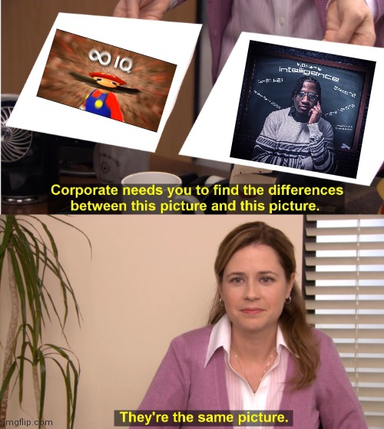
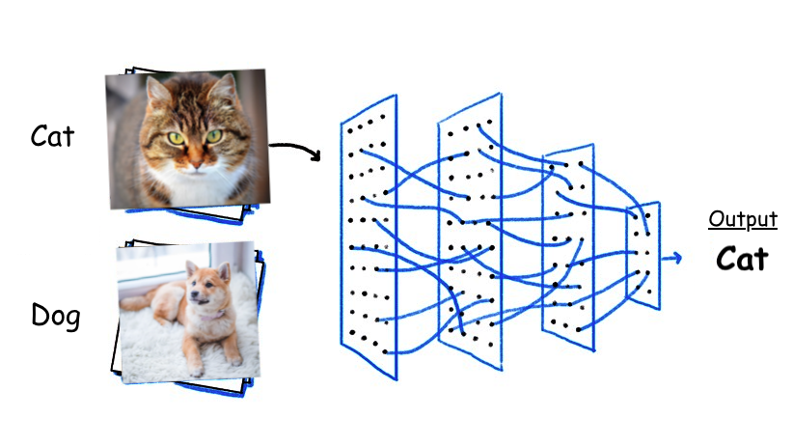
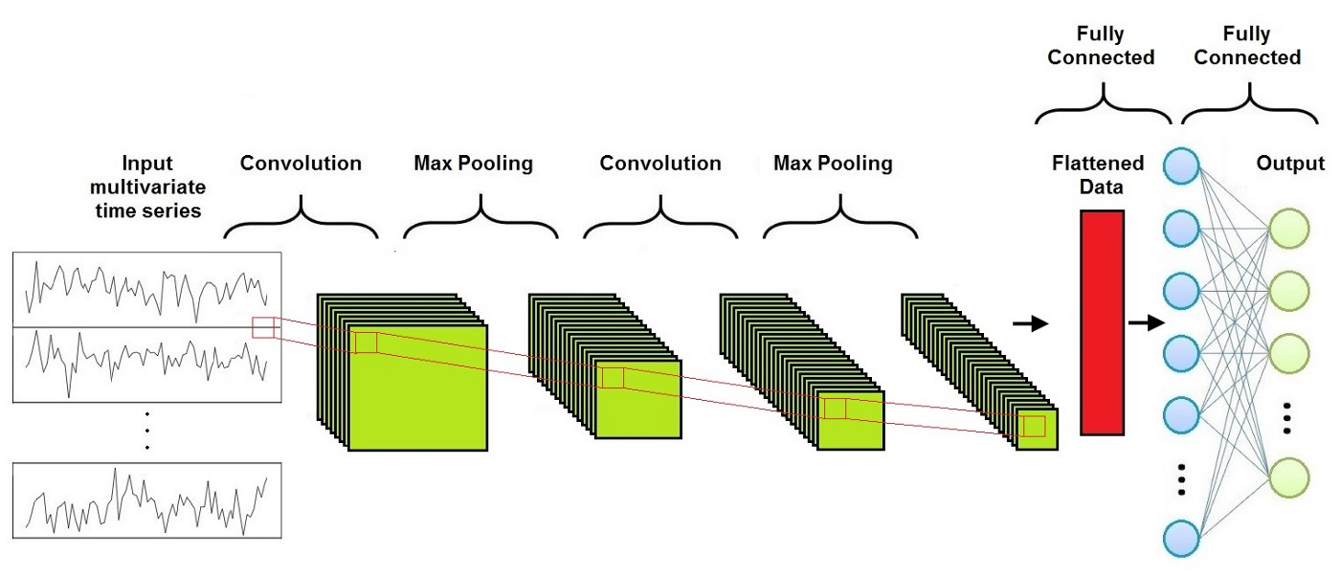
What is Task Similarity?
?
Notes:
how should we define task similarity?
consider these two classification tasks
should they deemed similar? If so, how similar?

Slide 47
(Learning) Meta-Features
Meta-Features describe e.g. the learning process, common concepts shared across tasks, …
Approaches:
manually design Meta-Features (e.g. compute statistics of each dataset we obtain such as number of samples, mean per feature, std per feature, correlations, …)
learn task-embeddings, i.e. learn a function f(x) that maps tasks (data + additional information such as descriptions) into a n-dimensional vector-space
these embeddings can be used together with algorithm configurations to build models predicting good hyperparameters for a given task
Notes:
how could we learn a task representation?
use VAE approach to encode data of different tasks into one vector space
then use cluster algorithm (e.g. k-means) to cluster tasks. The obtained clusters represent the tasks obtained
new tasks get embedded by the encoder. Then we can assign the task to the nearest (i.e. most similar) cluster

Slide 48
Few-Shot Learning
we train a model (NN) on some task t₁
now, we obtain that the task changed (e.g. due to a distribution shift), denote it as t₂
goal: use the parameters of the NN to adapt to t₂ as quickly as possible

Slide 49
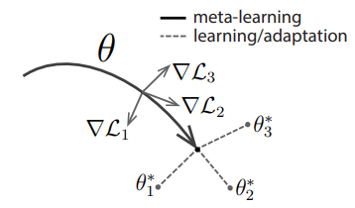
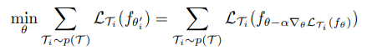
Model Agnostic Meta Learning (MAML)
aims to learn a set of parameters 𝜽 s.t. for any task from a distribution over tasks p(𝓣) we obtain a good performance after k gradient descent steps
i.e. find a good initialization for all tasks our distribution is defined over
push 𝜽 s.t. loss gets minimal after one GD-step
Notes:
we basically ask: How do we have to change theta in order to make the loss minimal after k steps of GD for each task?
i.e. where do I have to move theta in order to minimize the sum of task-losses after doing k steps of GD from theta?
imagine how you would proceed by yourself: Imagine a 2d-plane of parameters you can choose (x, y) and obtain a loss (z)
you would place theta on the parameter-plane s.t. you reach the minimum of each task-loss as fast as possible
i.e. a good strategy would be to move theta in the opposite direction of the gradient s.t. gradient increases
then we ensure that we quickly converge
this is exactly what the Hessian matrix tells us (i.e. the gradient of the gradient) → that’s also exactly what MAML is doing: change theta following the Hessian

Slide 50
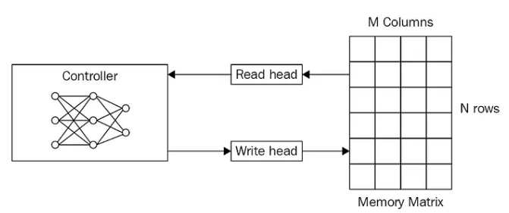

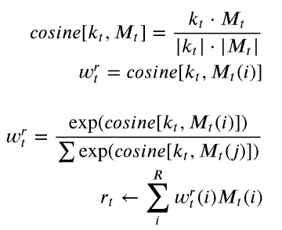
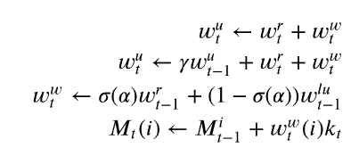
Memory Augmented Neural Networks (MANN)
That’s a Turing Machine!
Notes:
typically when you hear the term “memorizing” in ML/DL your alarm bells should ring!
usually it’s considered a bad thing since it implies overfitting
however: not in this case!
here, memorizing refers to really having an external storage system our network can make use of
we have a controller network (to produce a feature representation and some more important outputs for addressing memory)
we have a memory which is simply a NxM matrix
we have read and write heads
you might know this one: it’s a Turing Machine! That’s why it’s called a Neural Turing Machine (NTM)
one can define arbitrary addressing mechanisms for memory access
the original NTM paper defines content-based (associative memory) addressing and location-based addressing (something like RAM)
since we’re in Meta-Learning and we aim for grouping tasks by content-wise similarity we drop the location-based addressing here
for writing we aim to store new information at locations rarely being accessed
this thing can be trained end2end via SGD since it’s fully differentiable
MANNs have been shown to work well in meta-learning and continual learning settings

Slide 51

Meta-Learning and Lifelong Learning
Lifelong Learning deals with reusing old knowledge and update models faced with new tasks without forgetting old knowledge
to adapt to new tasks fast, having meta-knowledge is beneficial!

